Slide 1


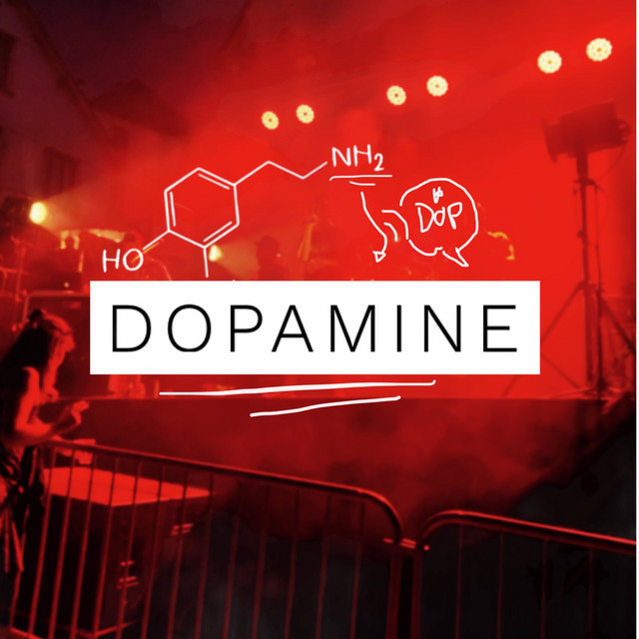
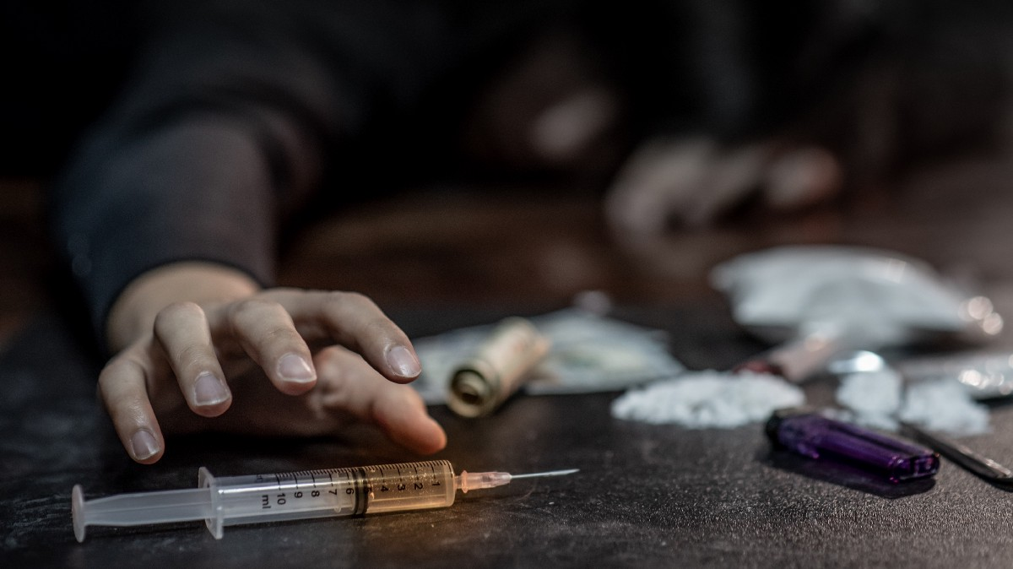
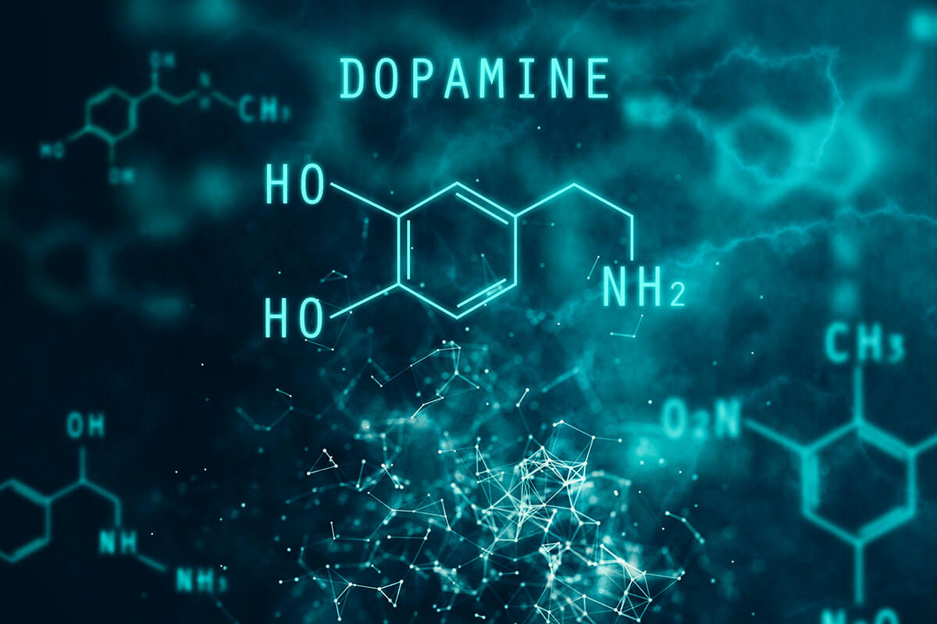
Dopamine
&
Addiction

Slide 2
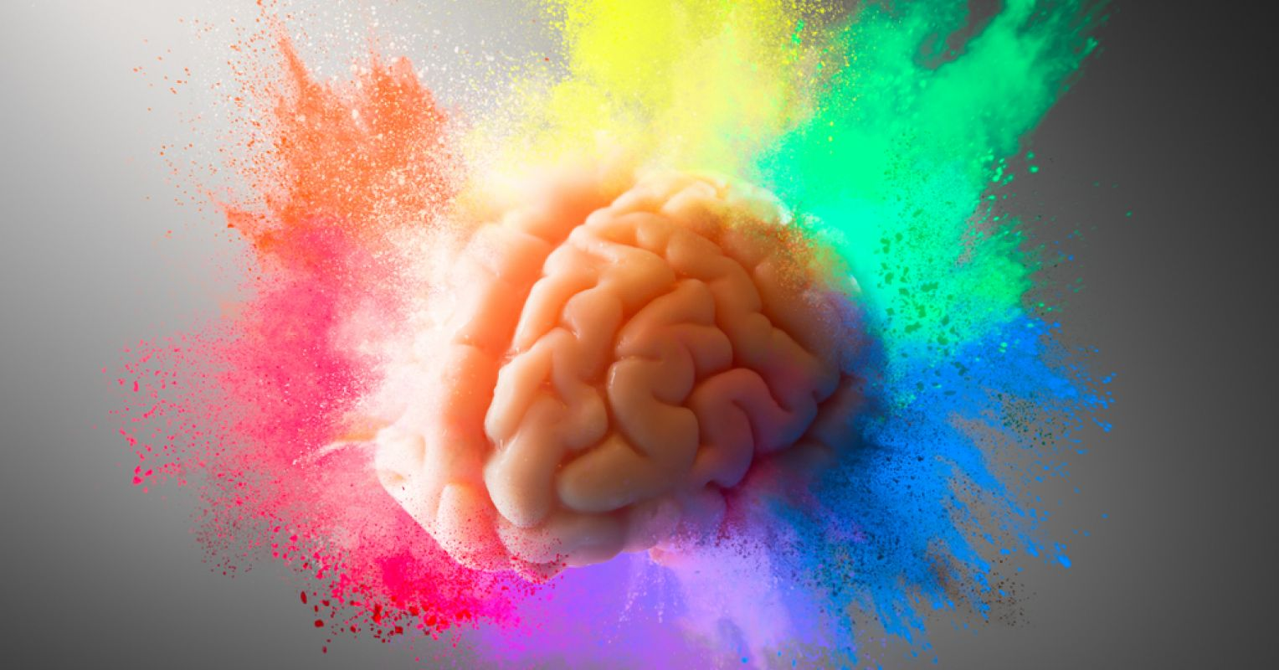
Part 1 :
What is Dopamine & it’s causes ?

Slide 3
Dopamine is a neurotransmitter made in the brain.
Dopamine is known as the “feel-good” hormone. It gives you a sense of pleasure.
It also gives you the motivation to do something when you’re feeling pleasure.
It acts as a chemical messenger between neurons.
It’s a part of the brain’s “Reward Center”
Communicating messages between nerve cells in your brain and your brain and the rest of your body.

Slide 4
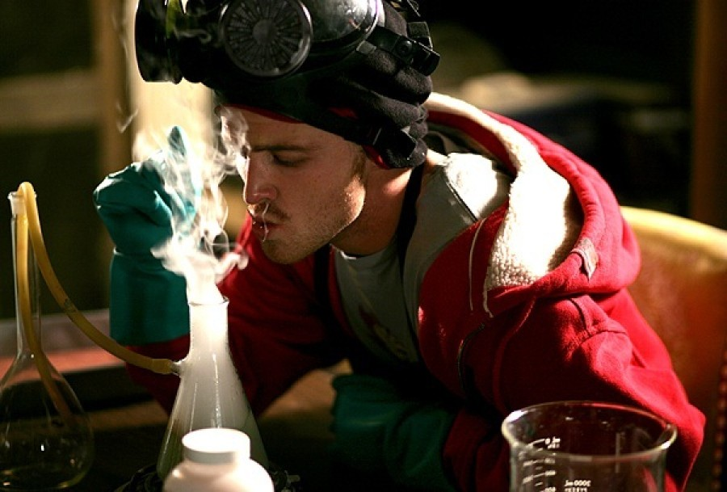
Part 2 :
Dopamine’s relationship to addiction

Slide 5

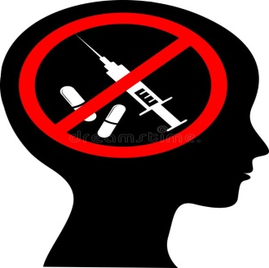







Slide 6
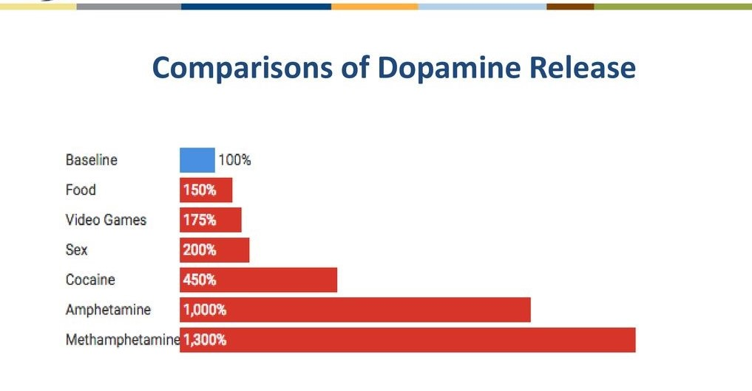

Slide 7
Part 3 :
What about getting used to addiction ?

Slide 8
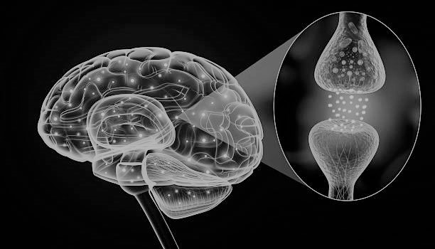

Slide 9
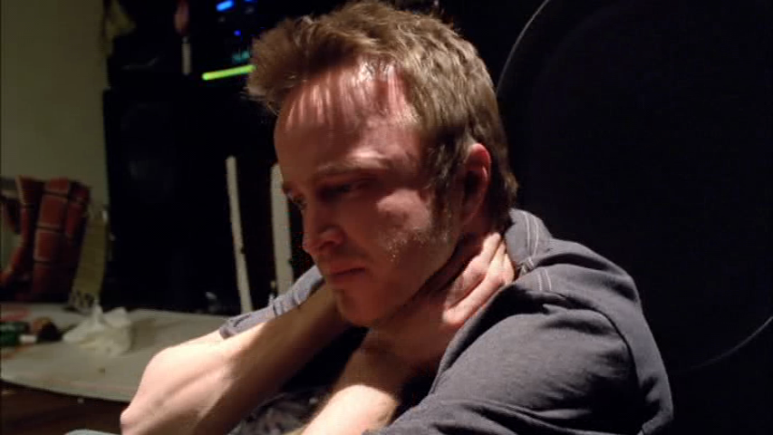
Part 4 :
Withdrawal symptoms of addiction and their causes

Slide 10
Withdrawal Symptoms are the combination of physical and mental effects
Muscle spasms
Tremor
Hallucinations
Depression
Insomnia
Difficulty in breathing
Severe headaches
itching body
Difficulty swallowing
Heaviness in talking & walking
Examples

Slide 11
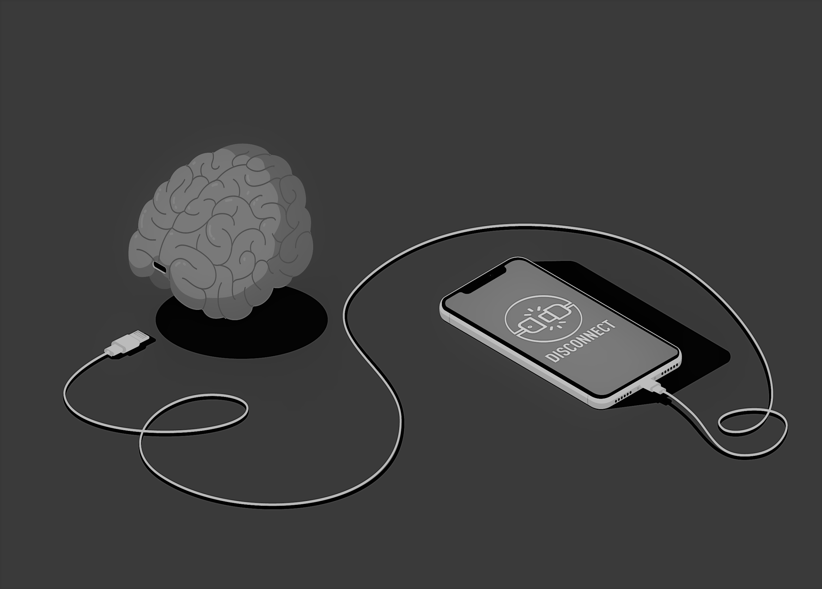
Part 5 :
Dopamine Detox

Slide 12
Dont’s
Social media
Movies
Music
Video games
Junk Food
High Calorie Food
Smoking
Al-Cohol
Gambling
Do’s
Talking to people
Cooking & eating
Going for walks
Reading books
Journaling
Exercising

Slide 13
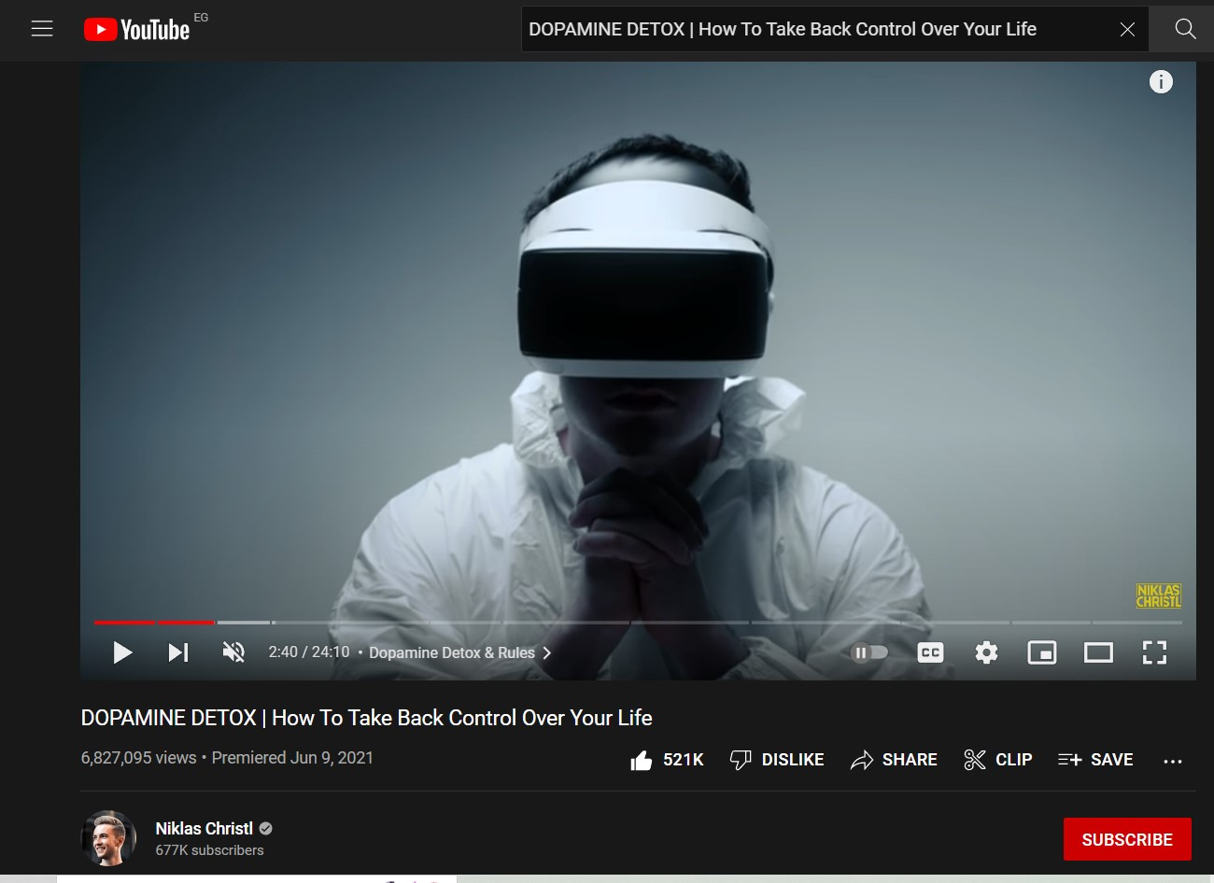
https://www.youtube.com/watch?v=bV_NdUZEmnE&t=161sh

Slide 14
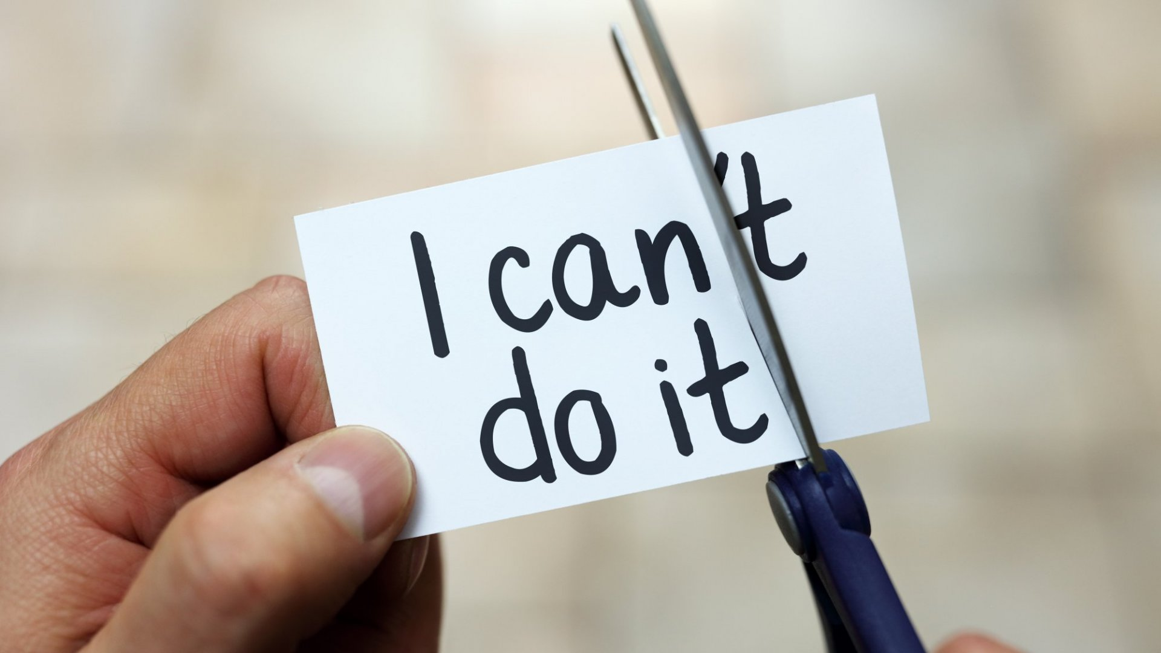
Part 6 :
How to get back to your Normal Life ?

Slide 15
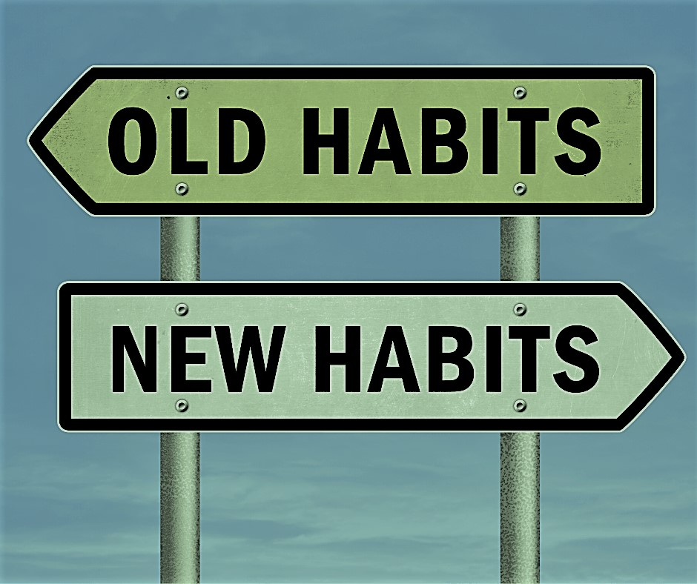

Slide 16
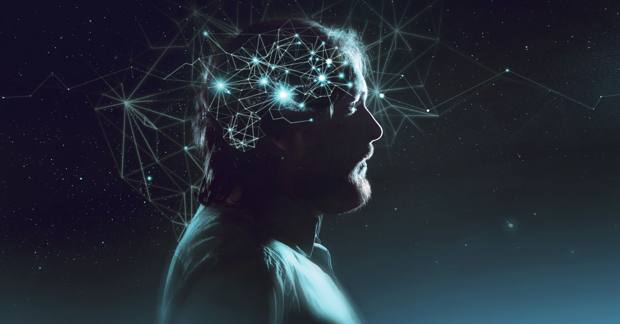
Part 7 :
What is the difference between Brain and Mind ?

Slide 17
Your Choices Identify You

Slide 18
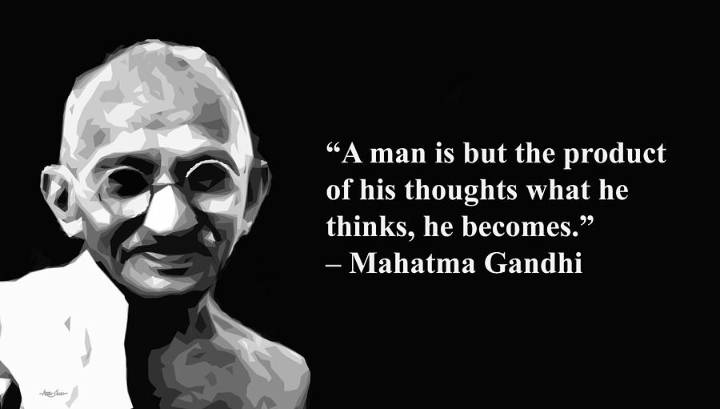

Slide 19

Thank You

